Slide 1
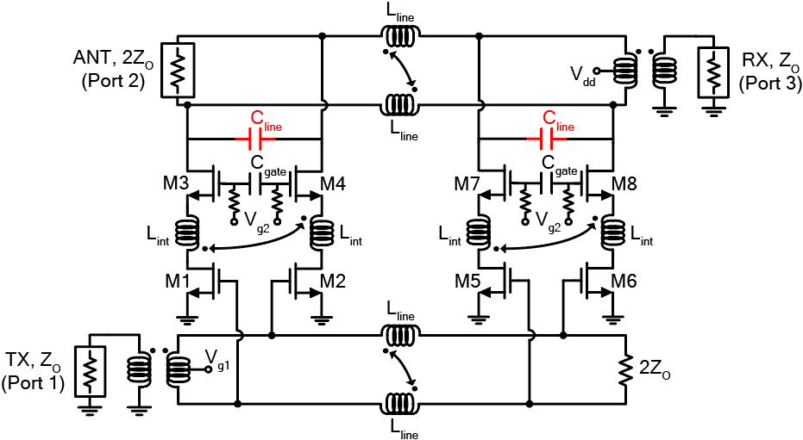
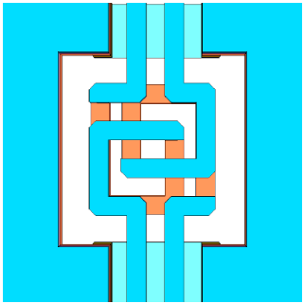
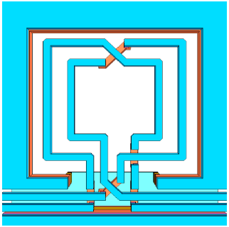
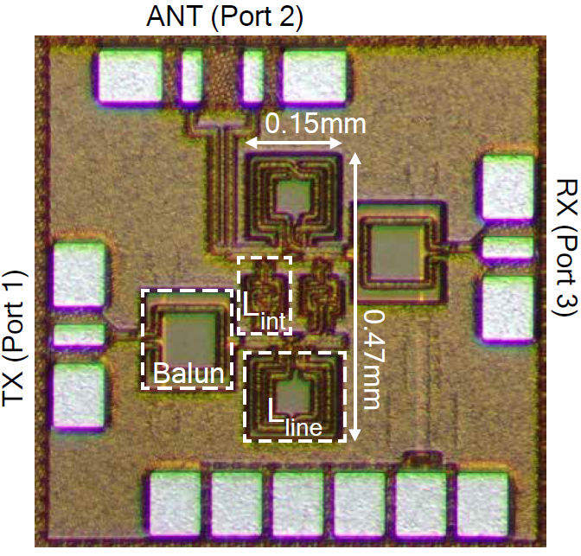
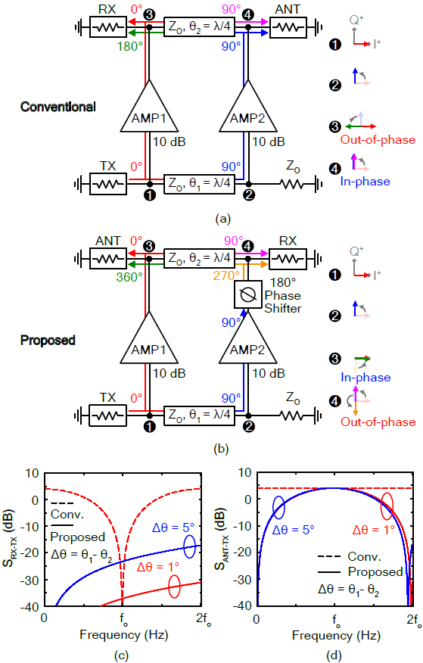
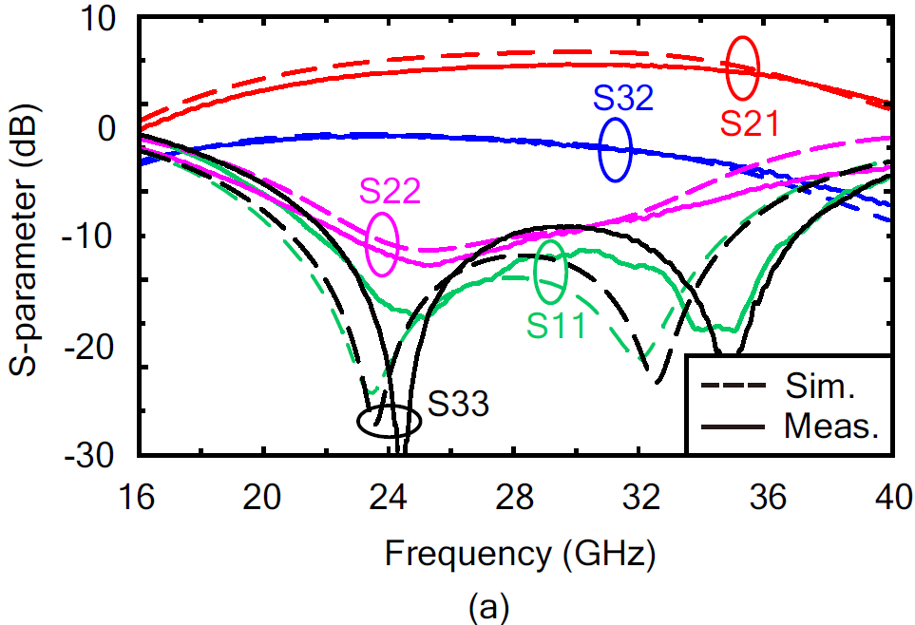
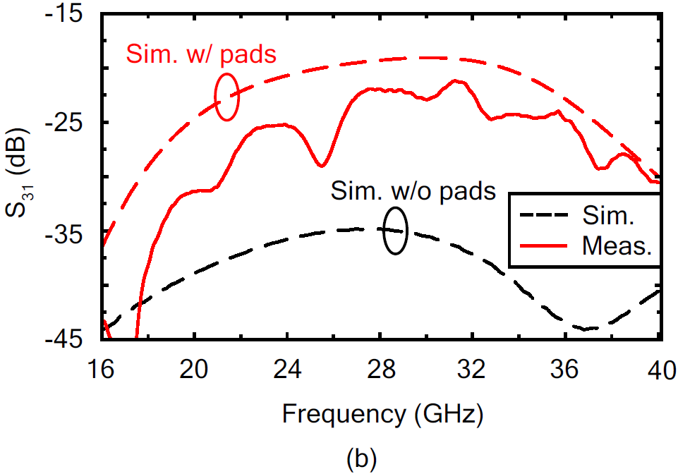
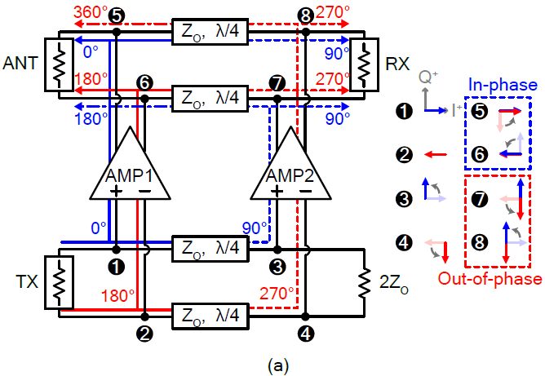
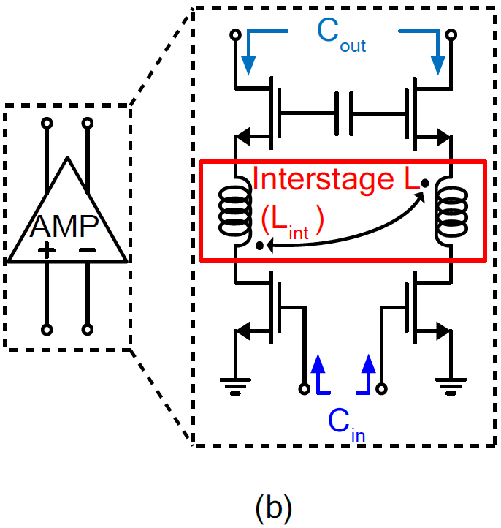
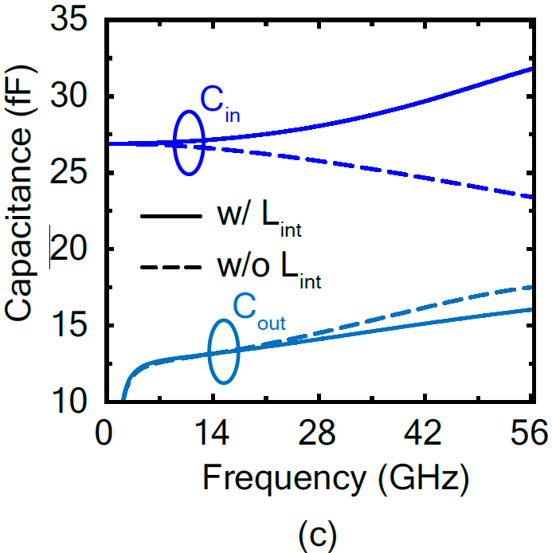
An Ultra-Wideband and Compact Active Quasi-Circulator With Phase Alternated Differential Amplifier
Dongho Yoo, Jun Hwang and Byung-Wook Min
Department of Electrical and Electronic Engineering, Yonsei University, Seoul, Korea
Schematic and Chip Photo
Abstract
Distributed amplifier based active quasi-circulator (QC)
Utilize phase alternated differential amplifier
Interstage inductors make the circulator more wideband
All the inductors are designed as coupled inductors
0.15 x 0.47 (0.07mm²) chip size with 28-nm CMOS
Design Concept
Measurement Results
Proposed Differential Active QC and Differential Amp Core With Interstage L
Conclusion
Active QC with phase alternated differential amplifier is presented
Wideband operation is realized by connecting the output of the second stage alternately to the first stage and using interstage L
Thanks to the coupled inductor, the size of the chip is only 0.07mm²
The TX to ANT peak gain is 4.5 dB and 20 to 38.5 GHz for 3-dB BW
The ANT to RX minimum insertion loss is 4.3 dB
The TX to RX isolation is over 21 dB
Acknowledgement
The chip fabrication and EDA tool were supported by the IC Design Education Center(IDEC), Korea.

